Slide 1
Introduction to
Compiler

Slide 2
What is a compiler?
  A program that reads a program written in one language (Source Language) and translates it into an equivalent program in another language (Target Language).
  Traditionally, the source language is a High Level Language and the target language is a Low Level Language (machine code).
    Two components
      Understand the program (make sure it is correct)
      Rewrite the program in the target language.

Slide 3
Compiler
Target
program
Source
program
Error message

Slide 4
Overview of
Compilation Process

Slide 5
Source program
Lexical Analyzer
Syntax Analyzer
Semantic Analyzer
Error Handler
Symbol Table
Management
Intermediate Code Generator
Code Optimization
Code Generation Phase
Target program

Slide 6
Source program
Lexical Analyzer
Syntax Analyzer
Semantic Analyzer
Error Handler
Symbol Table
Management
Intermediate Code Generator
Code Optimization
Code Generation Phase
Target program

Slide 7
Source program
Lexical Analyzer
Syntax Analyzer
Semantic Analyzer
Error Handler
Symbol Table
Management
Intermediate Code Generator
Code Optimization
Code Generation Phase
Target program

Slide 8
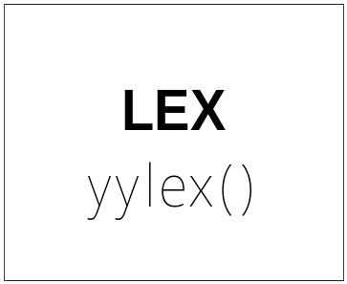
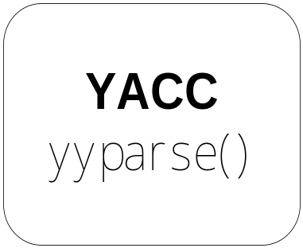
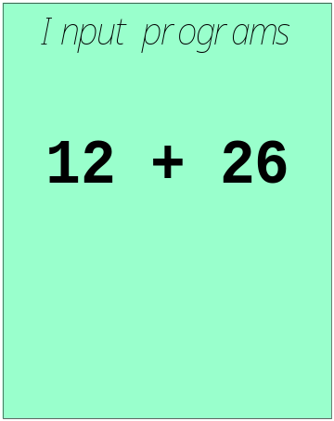
LEX and YACC: a team
How to work ?

Slide 9
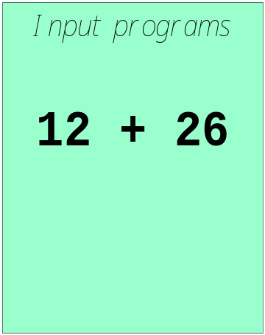
LEX and YACC: a team
call yylex()
[0-9]+
next token is NUM
NUM ‘+’ NUM
+
12 26
Syntax Tree

Slide 10
Introduction of
Semantic Analysis

Slide 11
Source program
Lexical Analyzer
Syntax Analyzer
Semantic Analyzer
Error Handler
Symbol Table
Management
Intermediate Code Generator
Code Optimization
Code Generation Phase
Target program

Slide 12
Semantic Analysis
Here Compiler tries to discover the meaning of a program by analyzing its Parse Tree or Abstract Syntax Tree.
Checks whether the SP is according to Syntactic and Semantic Conventions of Source Lang or not.
Also known as Context Sensitive Analysis.
Answer depends on Value not Syntax.
Attribute Grammar
Attributes on Symbols
Attribute Evaluation Rules
Indexing of Grammar Symbols

Slide 13
A program without grammatical errors may not always be correct program.
  pos = init + rate * 60
  What if pos, init and rate are real type ???
  This kind of errors cannot be found by the parser
  Semantic analysis finds this type of error and ensure that the program has a Meaning.

Slide 14
Semantic Analysis
Static Checking:
Performed at compile time
  Type checking
  Every variable is declared before used
  Identifiers are used in appropriate contexts
  Check subroutine call arguments
  Check labels
Dynamic Checking:
Performed at run time, and produces code that performs these checks
  Array subscript values are within bounds
  Arithmetic errors e.g. division by zero
  Pointers are not dereferenced unless pointing to valid object
  A variable is used but hasn't been initialized
  When a check fails at run time, an exception is raised

Slide 15
Type Checking:
- Type Check:
- Flow of Control Check:
- Uniqueness Check:
- Name Related Check:

Slide 16
Position of Type Checker:
Syntax Tree
Syntax Tree
Token
Stream
Parser
Type
Checker
Intermediate
Code
Generator
Interme
diate
Code

Slide 17
Type Systems:
Trapped Errors
Execution Errors:
Type Expressions:
Type Checking of Expression:
Type Checking of Statements:
Type Conversions:
Coercions:
Un-trapped Errors
Basic Types
Constructed Types
Complex Types

Slide 18
Semantic Analysis and Strong Typing
A language is strongly typed "if (type) errors are always detected"
  Errors are either detected at compile time or at run time
  Examples of such errors are listed on previous slide
  Languages that are strongly typed are Ada, Java, ML, Haskell
  Languages that are not strongly typed are Fortran, Pascal, C/C++, Lisp
Strong typing makes language safe and easier to use, but potentially slower because of dynamic semantic checks

Slide 19
Compilation in a Nutshell 1
Source code
(character stream)
if (b == 0) a = b;
Lexical analysis
Token stream
if
(
b
==
0
)
a
=
b
;
Parsing
if
==
=
;
Abstract syntax tree
(AST)
b
0
a
b
if
Semantic Analysis
boolean
==
=
int
;
Decorated AST
int b
int 0
int a
lvalue
int b

Slide 20


Slide 21
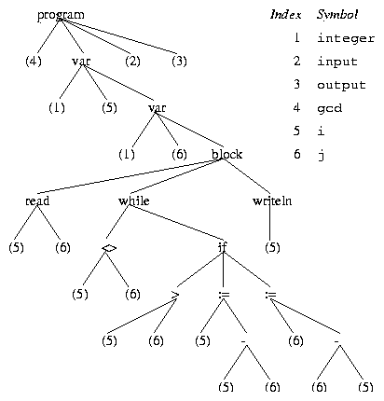
Code Generation and Intermediate Code Forms
A typical intermediate form of code produced by the semantic analyzer is an abstract syntax tree (AST)
The AST is annotated with useful information such as pointers to the symbol table entry of identifiers
Example AST for the
gcd program in Pascal

Slide 22
Code Generation and Intermediate Code Forms
  Other intermediate code forms
    intermediate code is something that is both close to the final machine code and easy to manipulate (for optimization). One example is the three-address code:
    dst = op1 op op2
    The three-address code for the assignment statement:
      temp1 = 60
      temp2 = id3 + temp1
      temp3 = id2 + temp2
      id1 = temp3
  Machine-independent Intermediate code improvement
      temp1 = id3 * 60.0
      id1 = id2 + temp1

Slide 23
Target Code Generation and Optimization
From the machine-independent form assembly or object code is generated by the compiler
      MOVF id3, R2
      MULF #60.0, R2
      MOVF id2, R1
      ADDF R2, R1
      MOVF R1, id1
This machine-specific code is optimized to exploit specific hardware features
Notes:
COP4020 Fall 2006

Slide 24
Compilation in a Nutshell 1
Source code
(character stream)
if (b == 0) a = b;
Lexical analysis
Token stream
if
(
b
==
0
)
a
=
b
;
Parsing
if
==
=
;
Abstract syntax tree
(AST)
b
0
a
b
if
Semantic Analysis
boolean
==
=
int
;
Decorated AST
int b
int 0
int a
lvalue
int b

Slide 25
Compilation in a Nutshell 2
if
boolean
int
==
=
;
int b
int 0
int a
lvalue
int b
Intermediate Code Generation
CJUMP ==
MEM
CONST
MOVE
NOP
Optimization
+
0
MEM
MEM
fp
8
+
+
fp
4
fp
8
CJUMP ==
Code generation
CX
CONST
MOVE
NOP
CMP CX, 0
CMOVZ DX,CX
0
DX
CX

Slide 26
Why Study Compilers? (1)
Compiler techniques are everywhere
  Parsing (little languages, interpreters)
  Database engines
  AI: domain-specific languages
  Text processing
    Tex/LaTex -> dvi -> Postscript -> pdf
  Hardware: VHDL; model-checking tools
  Mathematics (Mathematica, Matlab)

Slide 27
Why Study Compilers? (2)
Fascinating blend of theory and engineering
  Direct applications of theory to practice
    Parsing, scanning, static analysis
  Some very difficult problems (NP-hard or worse)
    Resource allocation, “optimization”, etc.
    Need to come up with good-enough solutions

Slide 28
Why Study Compilers? (3)
Ideas from many parts of CSE
  AI: Greedy algorithms, heuristic search
  Algorithms: graph algorithms, dynamic programming, approximation algorithms
  Theory: Grammars DFAs and PDAs, pattern matching, fixed-point algorithms
  Systems: Allocation & naming, synchronization, locality
  Architecture: pipelines & hierarchy management, instruction set use
Notes:
Au02: taken from one of Cooper’s slides

Slide 29
Summary
Compiler front-end: lexical analysis, syntax analysis, semantic analysis
  Tasks: understanding the source code, making sure the source code is written correctly
Compiler back-end: Intermediate code generation/improvement, and Machine code generation/improvement
  Tasks: translating the program to a semantically the same program (in a different language).

Slide 30
Scanner: Lexical Analysis
Lexical analysis breaks up a program into tokens
  Grouping characters into non-separatable units (tokens)
  Changing a stream to characters to a stream of tokens
program gcd (input, output);
var i, j : integer;
begin
read (i, j);
while i <> j do
if i > j then i := i - j else j := j - i;
writeln (i)
end.
program gcd ( input , output ) ;
var i , j : integer ; begin
read ( i , j ) ; while
i <> j do if i > j
then i := i - j else j
:= i - i ; writeln ( i
) end .

